Slide 1

Introduction To Machine Learning using Python

Slide 2

Index
Difference between AI, ML, Deep Learning
Prediction, Classification and Clustering
Supervised and Unsupervised Learning
Why Data Preprocessing is Important?
Missing Data
Categorical Data
Too much correlation problem
Parameter Domination Problem
How Data Preprocessing solves all mentioned probem?
Using Mean or Avg
Numerical value to Categorical
Splitting the Dataset
Feature Scaling
Polynomial Regression Model
Demo
Thank You

Slide 3
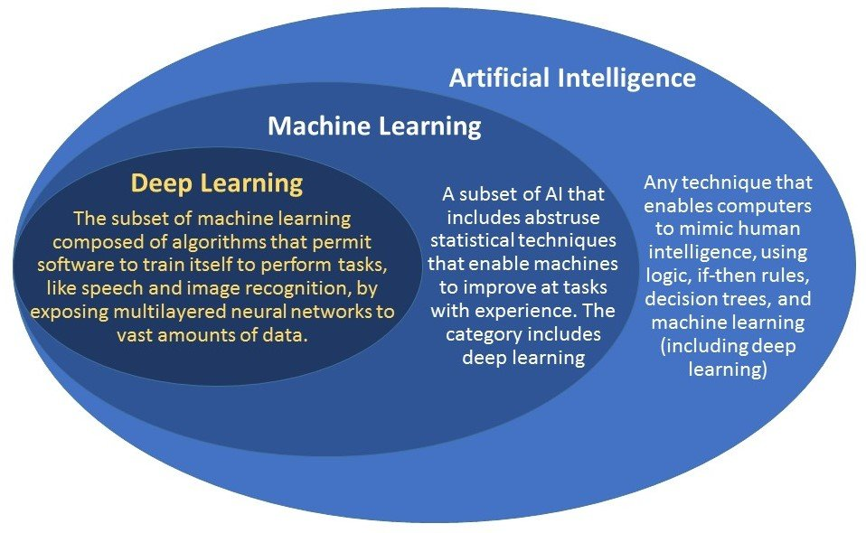
Difference Between AI, ML, DL

Slide 4
Prediction Vs Classification Vs Clustering
Prediction
Labelled Dataset : All parameters are already given and no requirement of finding them on which you must do prediction.
Mostly try to find numerical output like house price, house rent and more.
Input should be numerical form only since we are using mathematical formulas for training of model
Algorithms: Linear Regression, Polynomial Regression

Slide 5
Prediction Vs Classification Vs Clustering
Classification
Unlabelled Dataset : No parameters are given to machine and machine try to find all parameters using output correlation.
Mostly try to find to which classes it belongs.
Input can be in image form or numerical form.
Algorithm: CNN, Mostly Deep Learning Algorithms

Slide 6
Prediction Vs Classification Vs Clustering
Clustering
Unlabelled Dataset : No parameters are given to machine and machine try to find all parameters using close correlation of the same choices.
Mostly try to find to which group it belongs.
Input can be in image form or numerical form.
Algorithms: K-Mean , K-Median, KNN

Slide 7

Supervised Vs Unsupervised Learning
Supervised Learning
Input-Output Pairs
Mapping an Input to an output
Labelled Training Dataset
Predicted Labels can be both number and categories
Algorithms: Linear Regression, Polynomial Regression
Example: Suppose you want to predict the house prices (dependent variable) using different independent parameters (area, built, climate).

Slide 8
Supervised Vs Unsupervised Learning
2. Unsupervised Learning
Commonly used for Cluster Analysis
Hidden Pattern or Grouping in data
Unlabelled Training Dataset
Classification of different classes
Algorithms: K-Means or Clustering problems
Example: Clustering algorithms take data and use mathematical techniques to find groups of similar items or people as using that data and these can be easily be seen in amazon, Myntra recommendation systems.

Slide 9

Why Data Pre-processing is Important?
Missing Data
This issue is very common and is always there in the dataset i.e. you will never get all values in the dataset one or more values will be missing.
This missing values can lead to wrong prediction and loss of some important training data (since first thing you will think of is removing all the missing values row).

Slide 10
Why Data Pre-processing is Important?
2. Categorical Data
This is not a numerical value since we are using mathematical equation so these categorical data can't be used for training
Second option is removing them and then again it will lead to poor prediction of our machine because maybe our output is dependent on that categorical data

Slide 11
Why Data Pre-processing is Important?
3. Too Much Correlation Problem
Machine Learning uses correlation to learn about the dataset and make predictions but suppose if machine is learning too many correlations at the same time now it will lead to wrong results because machine is overfitted.
Example: Suppose take an example of student who learns by heart his lessons and then when he takes the exam he might be in trouble because he learned too much his lesson by heart and he does not manage to make the connection between what he learned and the exam asks and it goes same for machine learning we are going to build our machine learning models on a dataset but then we must test it on a new set which is going to be slightly different from the dataset on which we build the machine model.

Slide 12
Why Data Pre-processing is Important?
4. Parameter Domination Problem
Sometimes one parameter dominates other parameters since there values are too high compare to other parameter.
We use Euclidian distance to calculate distance between two value of one parameter.
Now, suppose we take example of two parameters like age and Salary now you can clearly see that if we try to find Euclidian distance between these two Salary will dominate the age now this can lead to wrong prediction.

Slide 13
How Data Pre-processing Solves all above mentioned problems
Imputer Library (solves Missing Data Problem)
Most used method is we replace missing value using the mean of all the value in that column.
Do above thing for all the other missing data also just remember replace it with mean of each missing column only.
Missing values in dataset is by default replaced by NaN.
Library Used: Imputer

Slide 14
How Data Pre-processing Solves all above mentioned problems
Giving Numerical Values to each Category Value (Solves Categorical One)
Encode text to number.
Example: Suppose we want to predict whether one person can purchase a property so, factors we are including are Country, Age, Salary, Purchased. Now here, you can clearly see that Country and Purchased are categorical data and these should be included to predict output.
Now, we will just indicate each country with unique number and purchased with (Yes - 1) and (No – 0).
Library Used: Label Encoder

Slide 15
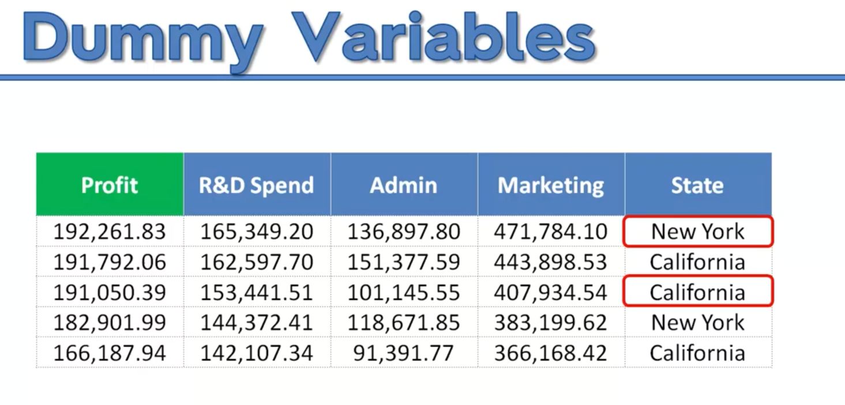
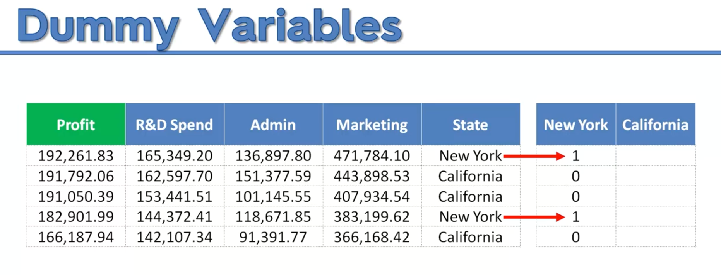
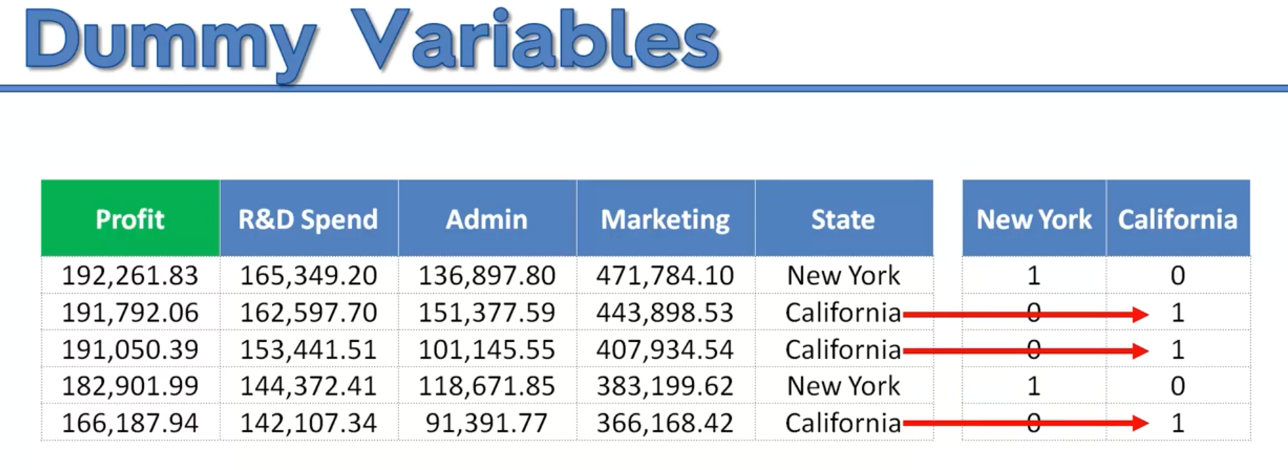
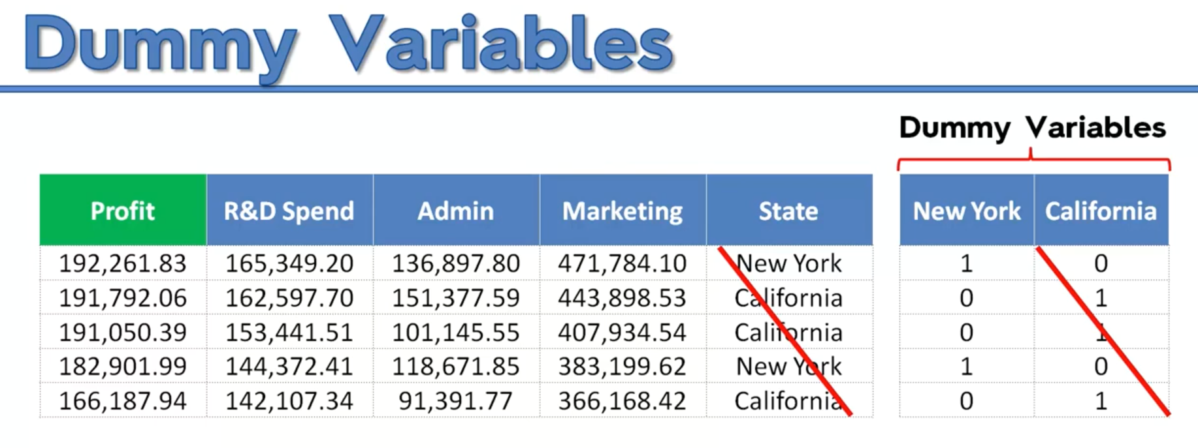
Dummy Variable

Slide 16
How Data Pre-processing Solves all above mentioned problems
Splitting the Dataset into Training and Testset (Too Much Correlation Problem)
Dataset is divided into two sets.
Mostly it is in 20:80 ratio.
80% is used for training the data.
20% is used for testing our trained model so that our machine has not seen this data.
Library Used: Cross Validation

Slide 17
How Data Pre-processing Solves all above mentioned problems
Feature Scaling (Parameter Problem)
Put Variables on same scale
Transform Variable to have values in same range.
Mostly Range will be from –1 to +1.
Two Methods :
Standardisation : X_{mean} = x-mean(x)
Standard deviation(X)
Normalisation : Xnorm = x-min(x)
Max(x) - Min(X)
Library Used: Standard Scalar

Slide 18
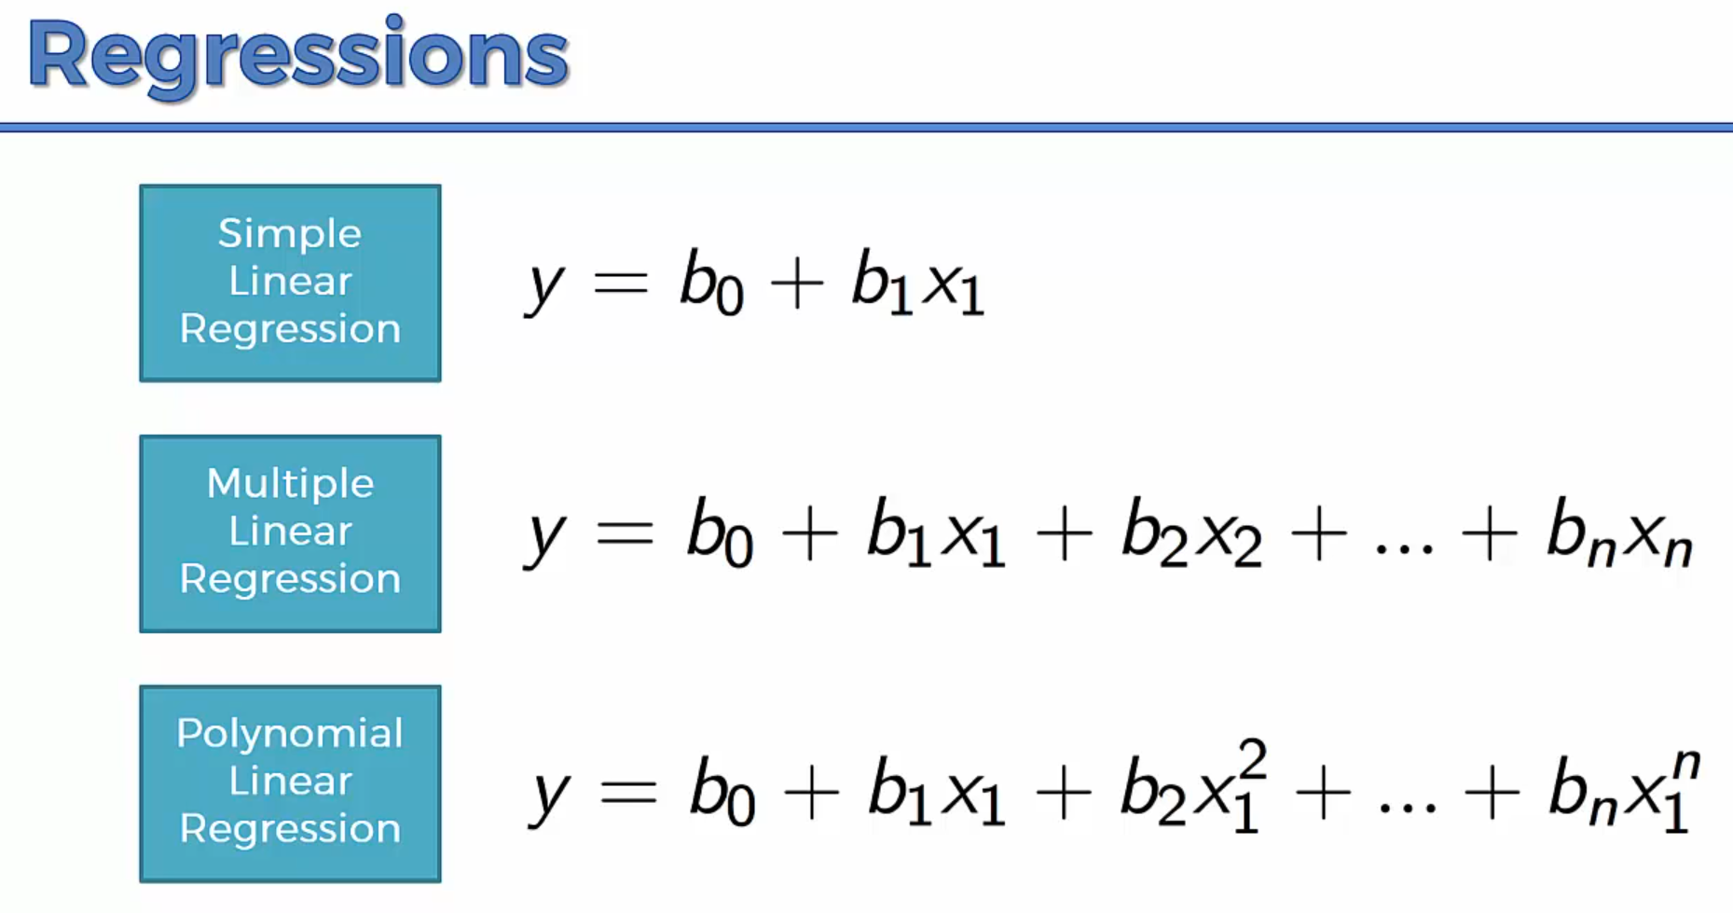
Polynomial Regression

Slide 19
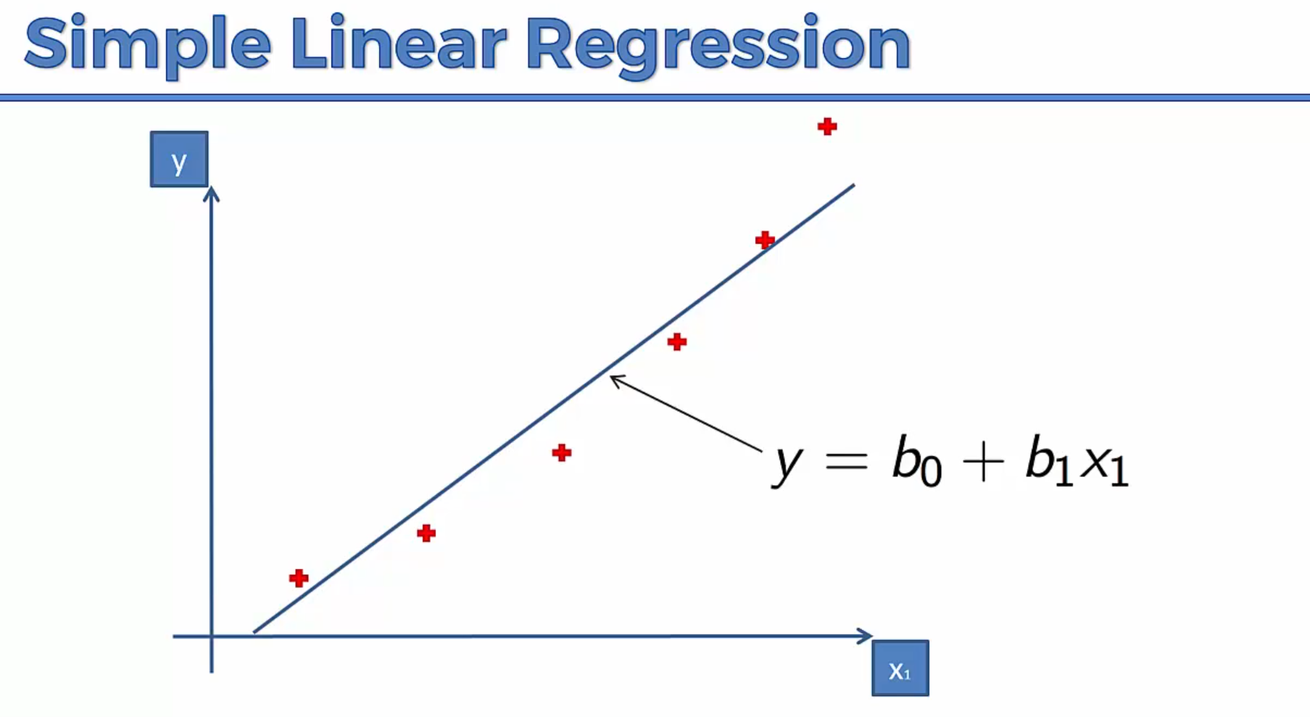
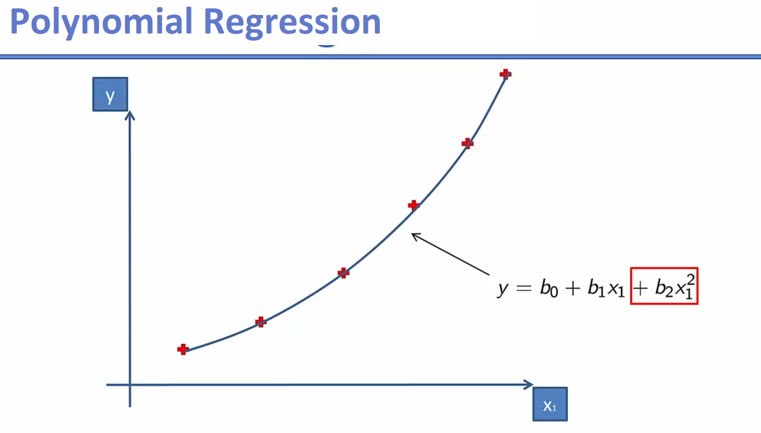
Polynomial Regression

Slide 20
DEMO Data Pre-Processing Link: Data Pre-Processing Dataset for Data Pre-Processing: Dataset Polynomial Regression Model: Polynomial_Model Dataset for Polynomial Regression: Dataset

Slide 21
THANK YOU

